Slide 1
IBM Applied Data Science Capstone Project – The Restaurant Battle of Neighbourhoods in Cologne, Germany
Ayoub Nassiri
20 Feb 2021

Slide 2
Table of contents
• Introduction: Business Problem
• Data
• Methodology
• Results and Discussion
• Conclusion
• Reference

Slide 3
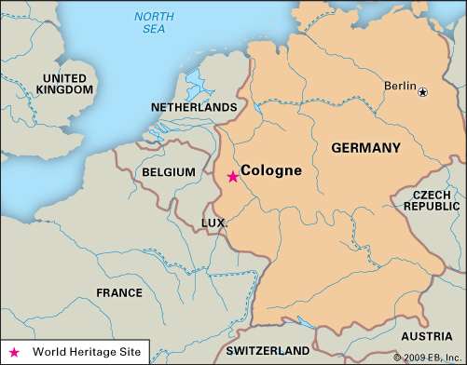
Introduction: Business Problem
Cologne, the city the author lives in, attracts a large number of tourists, not least due to its famous cathedral, the trade fairs and conventions, such as the gamescom, and its vibrant party scene.
For tourists, finding the right place to eat can be a challenge, though. German dishes include a lot of meat, often pork, which many people do not want to eat for health-related, religious, cultural or moral reasons. This is just one motive for giving tourists a good overview about what to eat where.
The goal I want to reach with this exercise is to give a simple recommendation to tourists in Cologne: in which district of the city will you find a large number or even concentration of which types of restaurants? Where to eat Mediterranean food, where to find German food, where to get fast food?
The target audience are the foreign tourists.

Slide 4
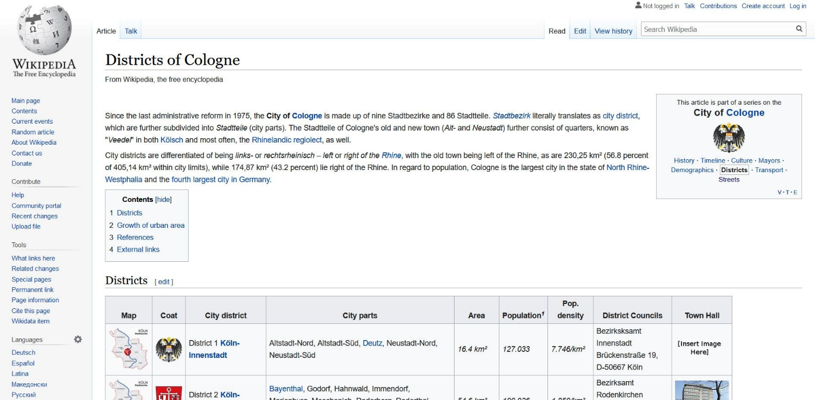
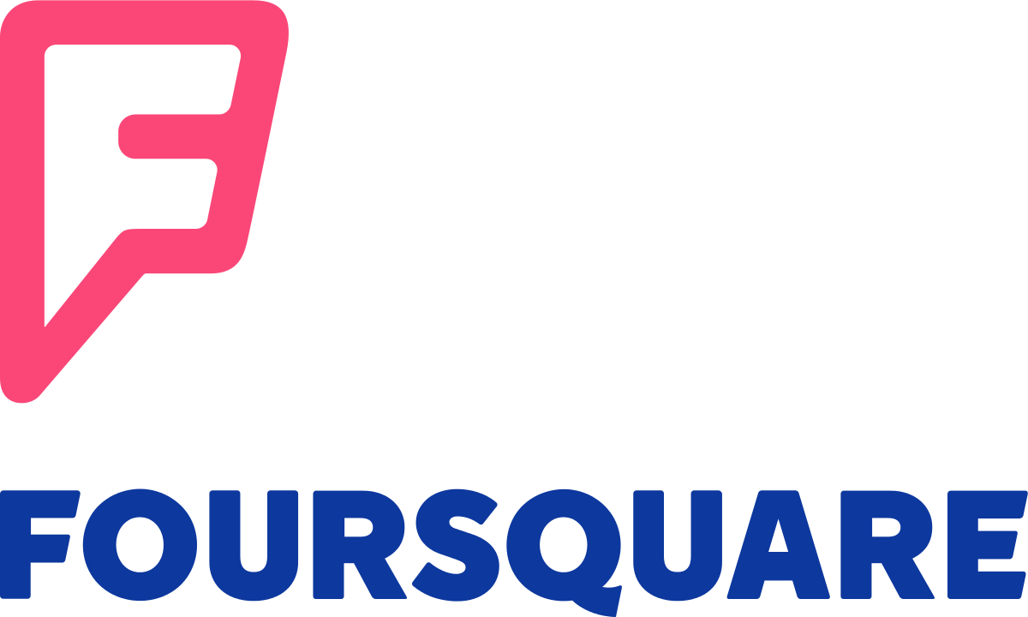
Data
I will use foursquare data about restaurants in Cologne.
Foursquare is a US tech company from New York focusing on location data. Their technology and data powers apps such as Apple's Maps, Uber, Twitter and many other household names.
I will use foursquare data such as the restaurant name, ID, location and category of food (vegetarian, Italian etc.).
Also, I will use the overview of districts/city parts of Cologne from Wikipedia.

Slide 5
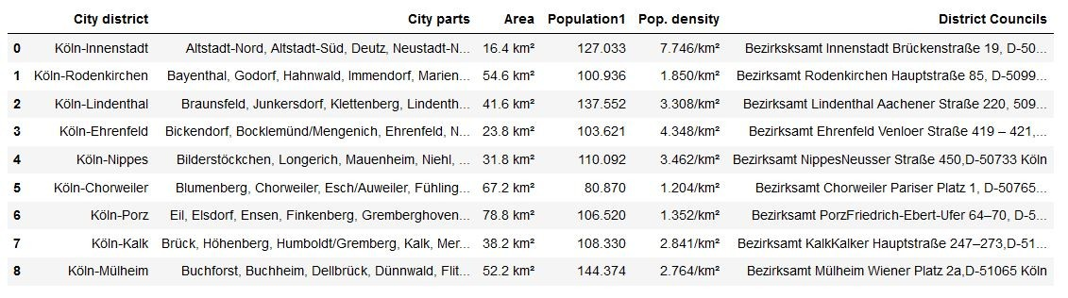
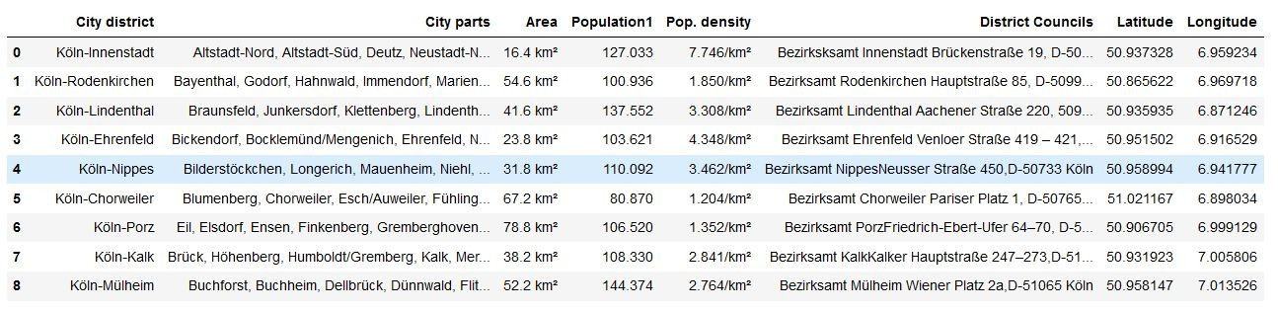
Methodology (1/3)
I scraped data from Wikipedia to create a dataframe with the city districts of Cologne. For this, I used the pandas read function. I had to clean the resulting data frame in terms of unnecessary information or data that could not be handled in a data frame, such as picture data of the coat of arms of each district. The result is a nice data frame:
I enabled geopy functions by installing the conda-forge geopy package. I used the nominate function to add geospatial data to the data frame, that is the latitude and the longitude seen on the right side of the following table.

Slide 6
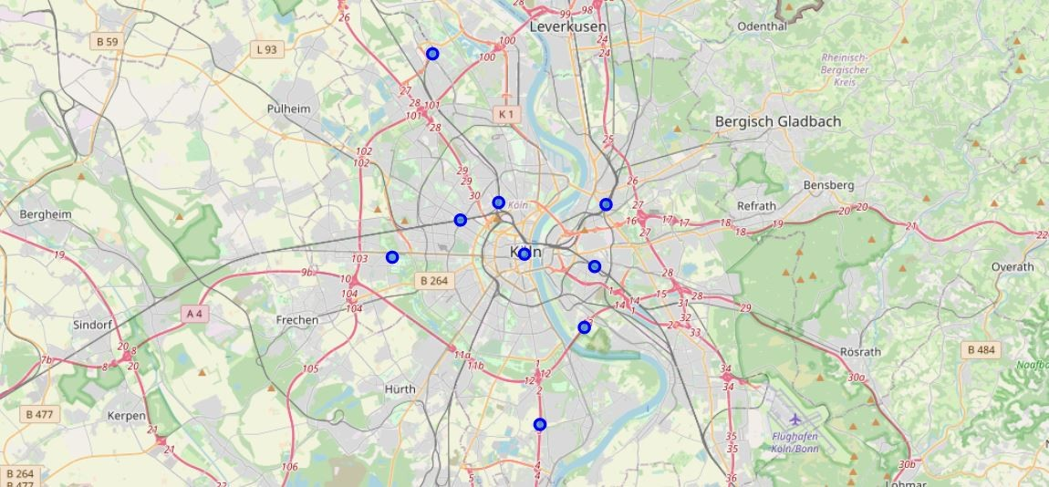
Methodology (2/3)
Using the folium package and my data frame, I then created a map with the nine city districs on it.

Slide 7
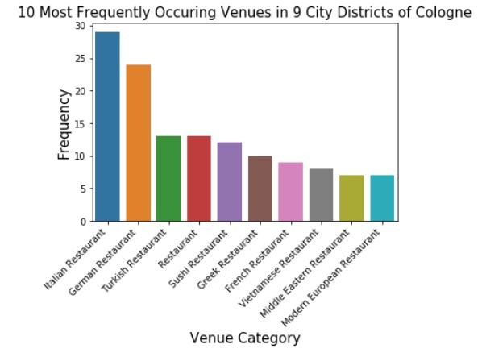
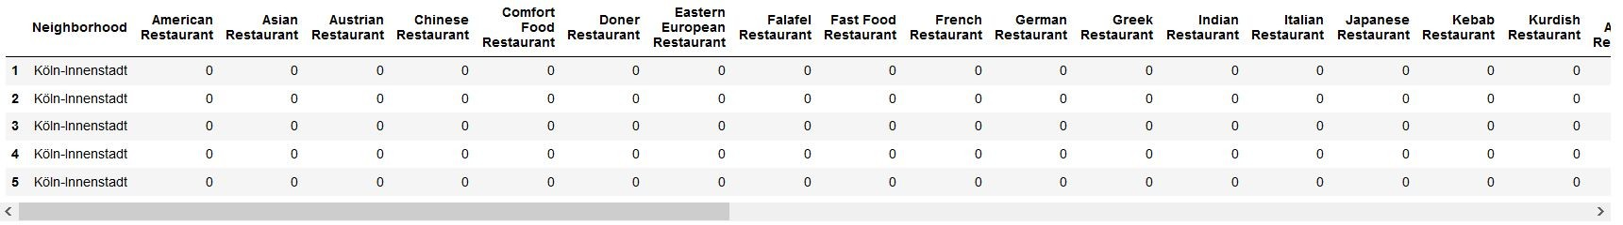
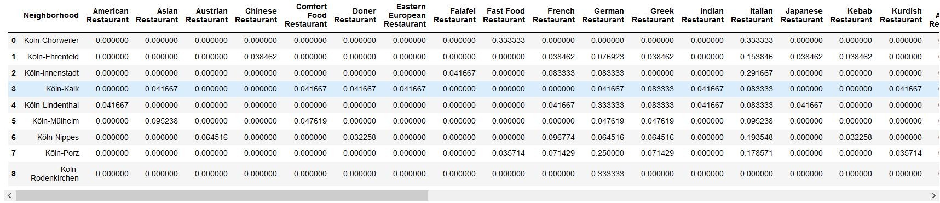
Methodology (3/3)
Now, foursquare data comes into play. I plotted a bar chart with the frequency of the 10 most frequently occuring restaurants in the whole city, using seaborn/matplotlib packages. We can see that Italian, German and Turkish restaurants are the most frequently occuring restaurants in Cologne.
To find clusters of restaurant types in the different city districts, I first transformed the data frame with the restaurant venues, associated to city districts, by one-hot encoding (0/1), as seen in the picture below.
Next, I used grouping to show the frequency of each category of restaurants in each city district. I used this information to create a data frame in which you can see the most common restaurant venue types for each city district.

Slide 8
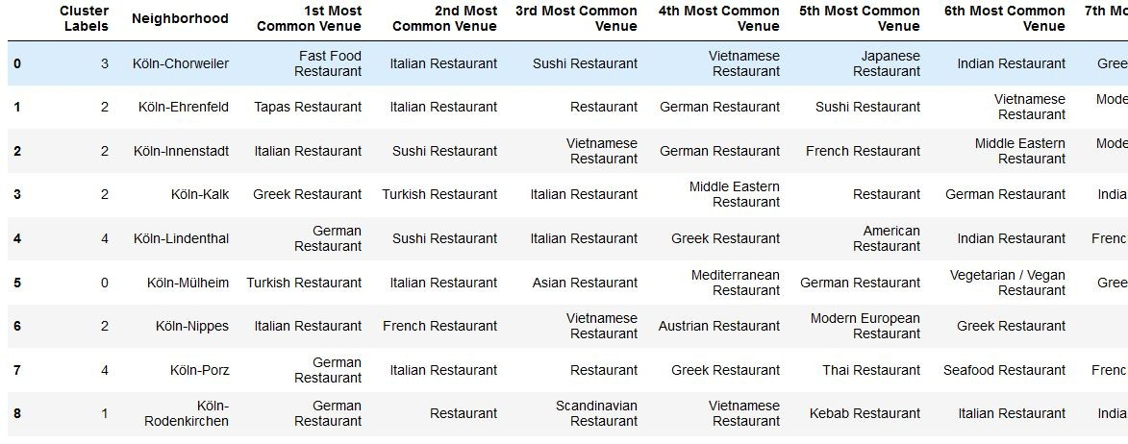
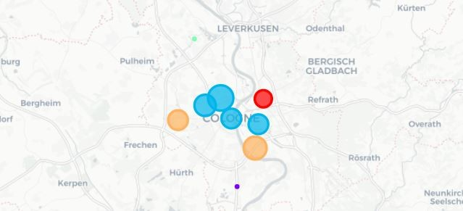
Results (1/3)
What we see in the table are the city districts and their most common venues, and they now have been assigned five different cluster labels from 0 to 4. We can now use the cluster labels to show the city districts marked with a cluster-specific color on a map, again using folium.
You will see nine bubbles for the nine city districts, with five different colors for the five different clusters. If you have trouble counting to five here, look for a small green dot on the upper part of the picture and a small purple dot on the lower part of the picture.

Slide 9
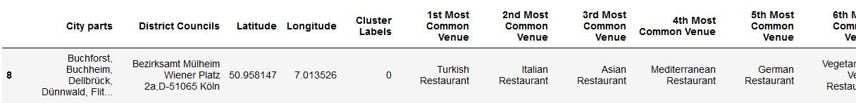
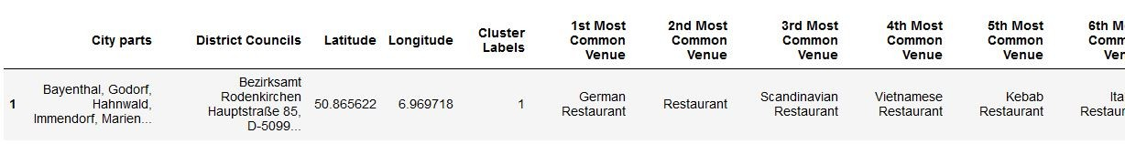
Results (2/3)
We now can show five clusters of restaurant type concentrations for the city of Cologne, which I named according to the restaurant concentration the data shows.
Cluster 1 - the Turkish Food Cluster (Mülheim)
Cluster 2 - the Northern European Food Cluster (Rodenkirchen)

Slide 10
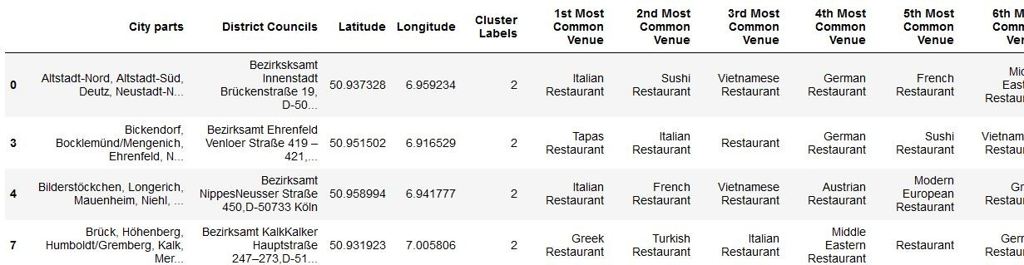
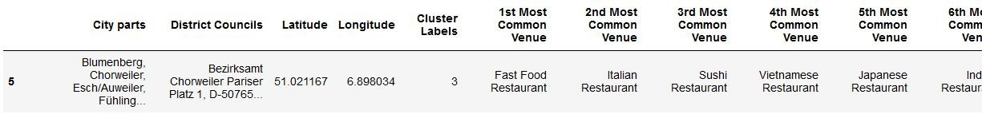
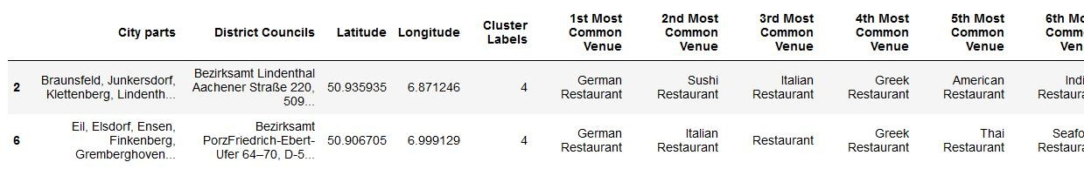
Results (3/3)
Cluster 3 – The Mediterranean Food Cluster (Innenstadt, Ehrenfeld, Nippes, Kalk)
Cluster 4 – The Fast Food Cluster
Cluster 5 - the German/Diverse Food Cluster (Lindenthal, Porz)

Slide 11
Discussion
If I reflect the work necessary to create these results, what comes to my mind is that for typical ways of scraping, cleaning, handling, transforming and visualizing data, all the tools are simply there. We just have to get to know the available open source packages and learn how to use them.
What I find fantastic is that nearly all of them are free of charge. Also, a simple notebook computer is enough: in my case, I used a ThinkPad L470, more than three years old.
All the rest is concentrated, creative, interesting, sometimes hard work and searching for hints, tips, examples, explanations etc. in the web. With these tools, many exciting data science use cases can be created, for all kinds of useful purposes.

Slide 12
Conclusion
We achieved the goal presented at the outset of this blogpost: tourists can see in the results which city districts best match their food desires. This is just one example of fantastic data science uses cases one can realize applying technology which is available for free today! What a time to be alive.

